Slide 1

Student attendance system using QR code and MAC address
Jana Massadeh 2019980056
Dana Mustafa 2018980153
Prof Amin Alqudah
Notes:
Line spacing + Page numbers

Slide 2
Road map
01 Introduction
02 Design
03 Implementation
04 Future works& Results
05 Conclusion

Slide 3
Introduction
01
What Tick Me?
Why Tick Me?

Slide 4


What Tick Me?
Tick Me a university website To take attendance and absence electronically, with its full approval on the QR code.

Slide 5
Why Tick Me?
To speed up take attendance and absence process.
Save time .
Enhance the educational process.
Ensure the accuracy of attendance and absence data .

Slide 6
Design
02

Slide 7
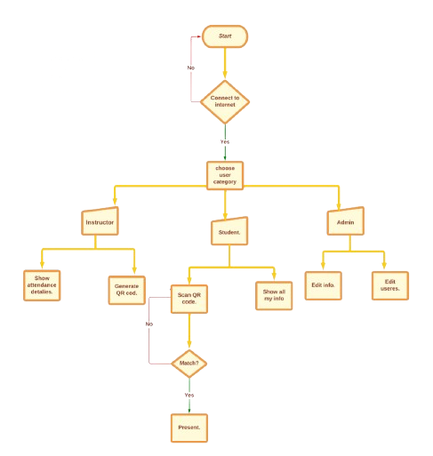
Design
On our website, the instructor can take attendance and absence electronically, easily and smoothly, without the need to exert effort and waste time, and evaluate the students based on their attendance, and it allows the students to track the days of their attendance, absence., and status in the course.

Slide 8




Design
We use :
HTML ,CSS and JS to program front end.
Asp. Net(C#) to program back end.
SQL to store all data for website users and information's

Slide 9
Implementation
03
Authentication
Login
Reset Your Password
Services

Slide 10
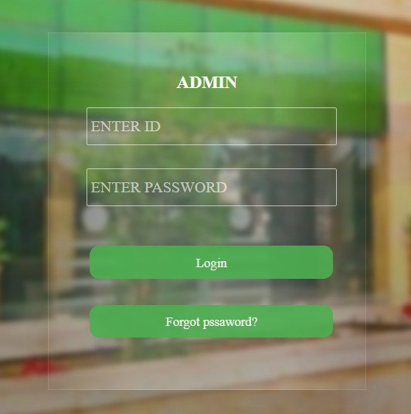
Implementation
Authentication
Login

Slide 11
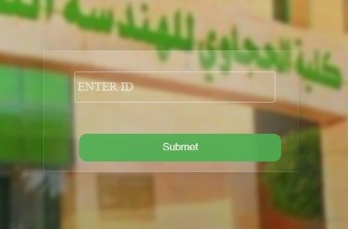
Implementation
Authentication
Reset Your Password

Slide 12
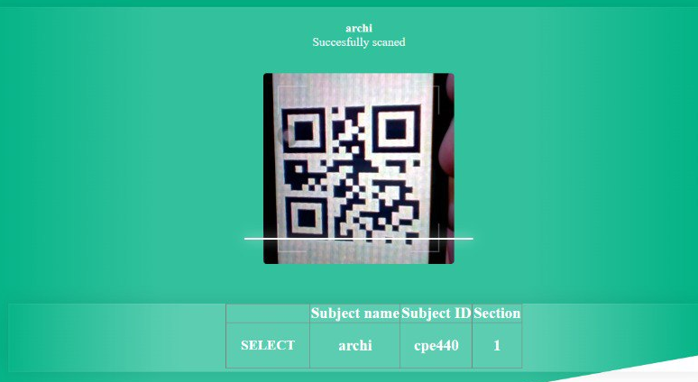
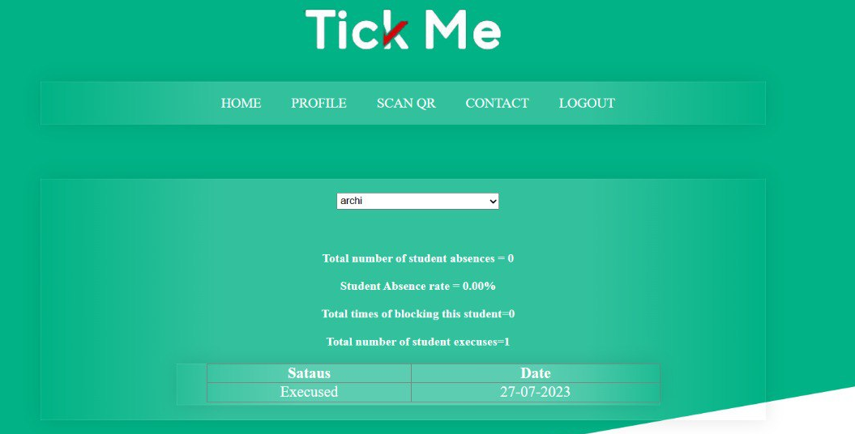
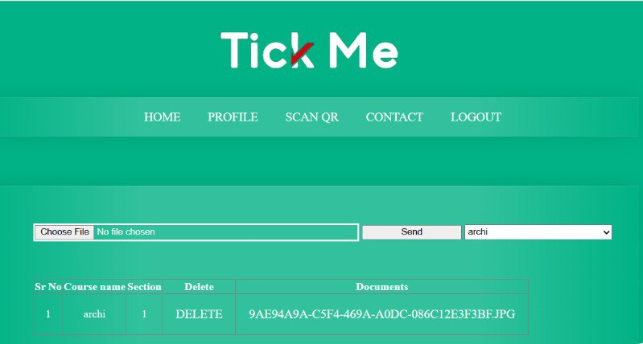
Implementation
Services
For student:
Upload excuses.
Scan QR.
Absence details.

Slide 13
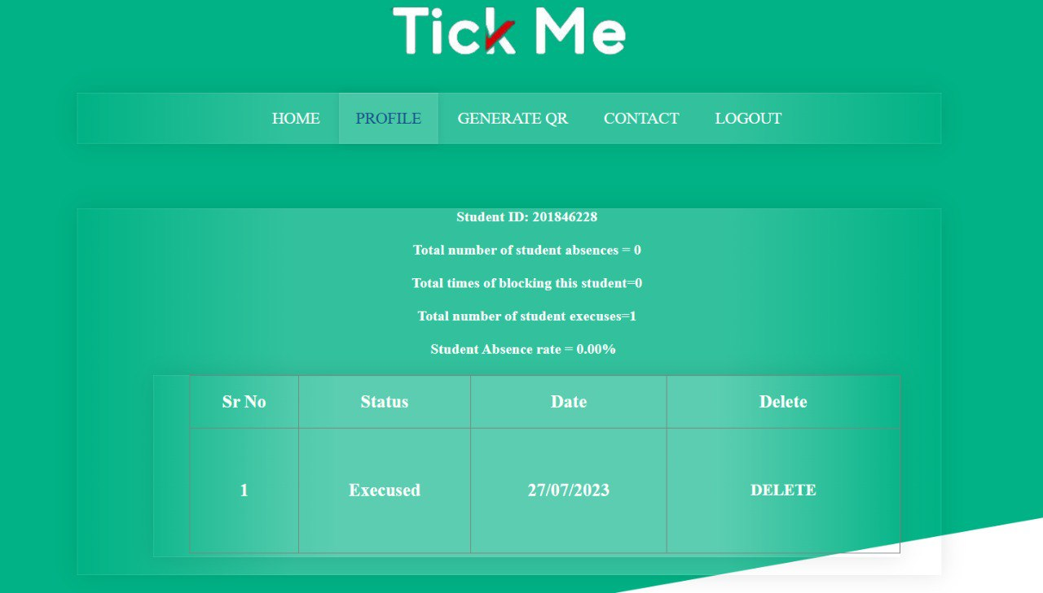
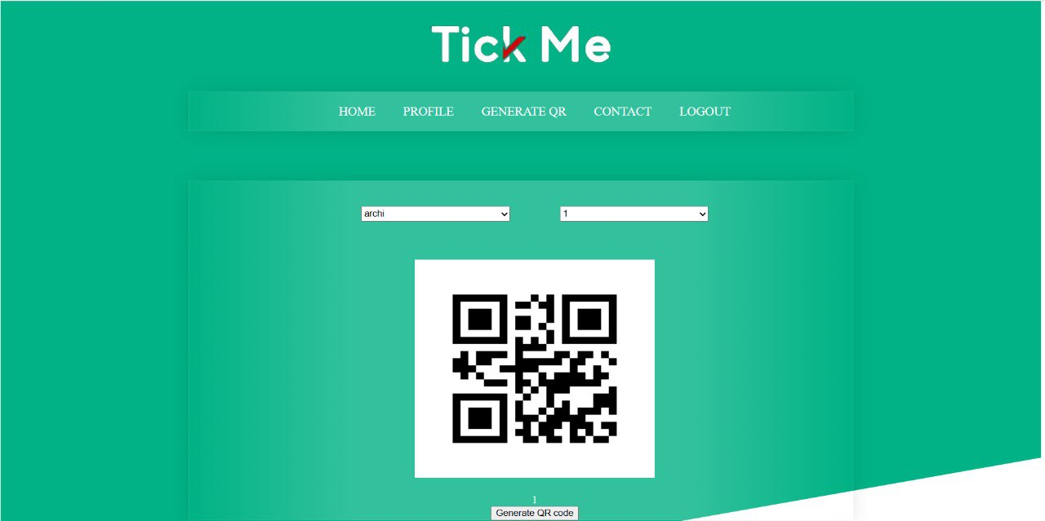
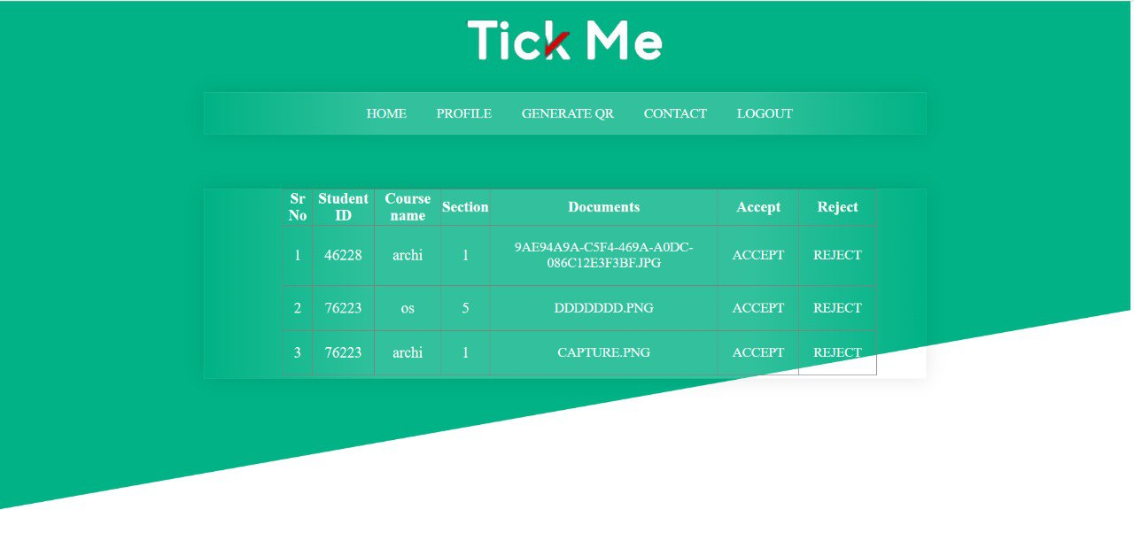
Implementation
Services
For instructor :
Generate QR code
Absence details for each Subject and each student.
Receive absence excuses.

Slide 14
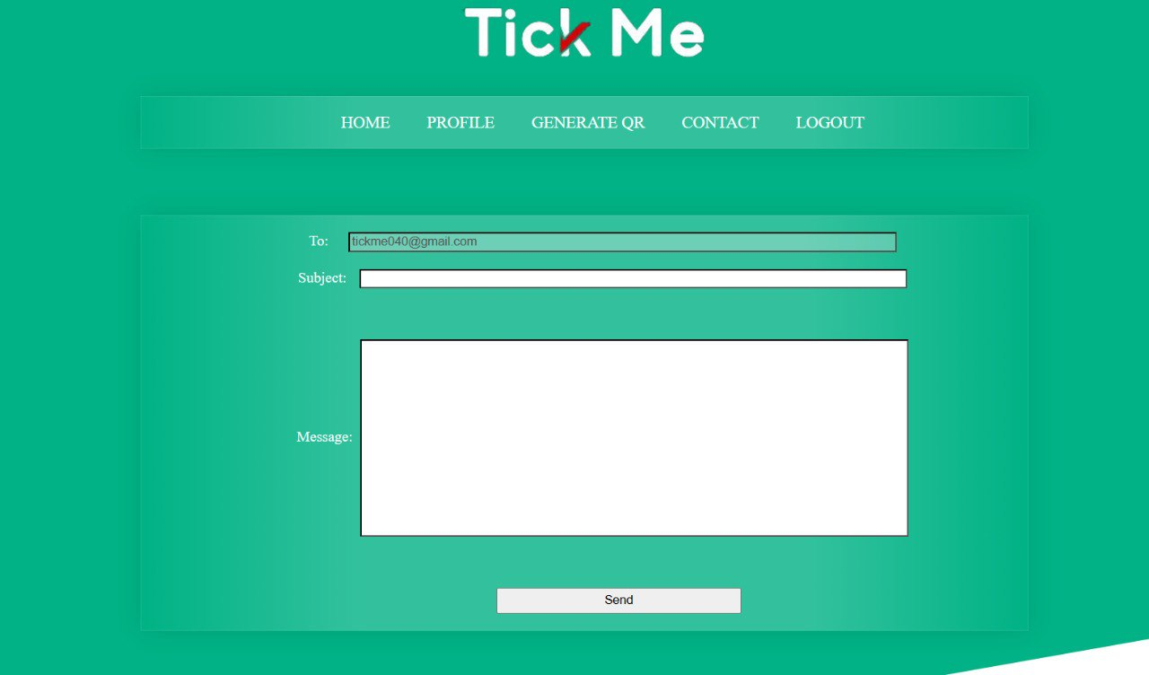
Implementation
Services
For instructor and student :
Contact us.

Slide 15
Future works& Results
04

Slide 16
Future works& Results
Results:
time and effort and use it to give the lecture
Follow the student's attendance with ease. and evaluate it.
Facilitating the student to present his excuses for not attending his lectures or exams.
Taking attendance and absence daily.
Future work:
Expanding to include exam attendance.
Mobile application.
Geolocation feature.

Slide 18
Conclusion
Excuse management system.
Automatic generation of unique QR codes.
Easy-to-use attendance system.

